Slide 1
TT05 Gray Code Counter (Software Setup)
Icarus Verilog/Verilator
Downloaded the previous team’s design and wrote a verilog test bench
Was able to test the design’s output
QSpice
Integrated Verilog with Spice simulation to get a transient analysis
Noticed voltage output is the verilog output

Slide 2
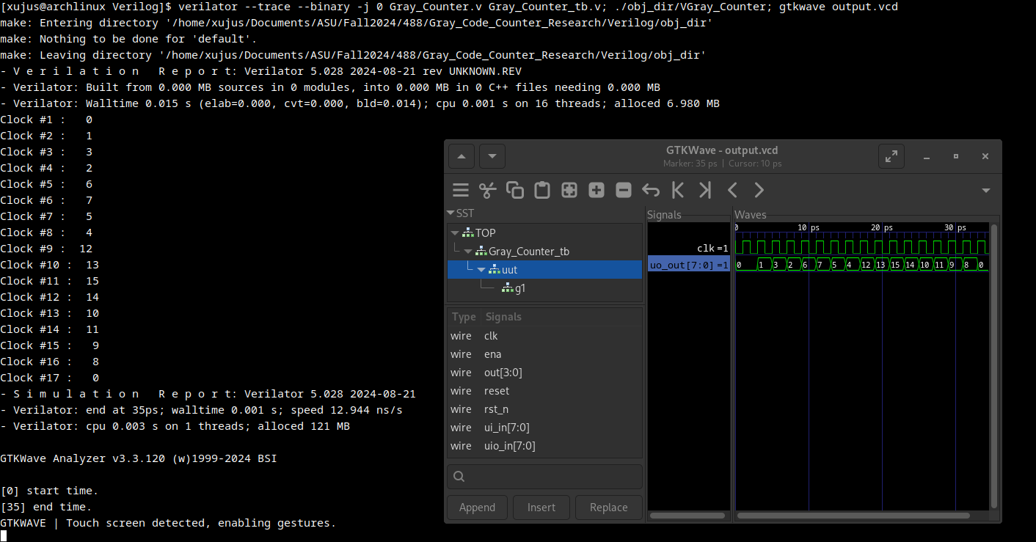

Slide 3
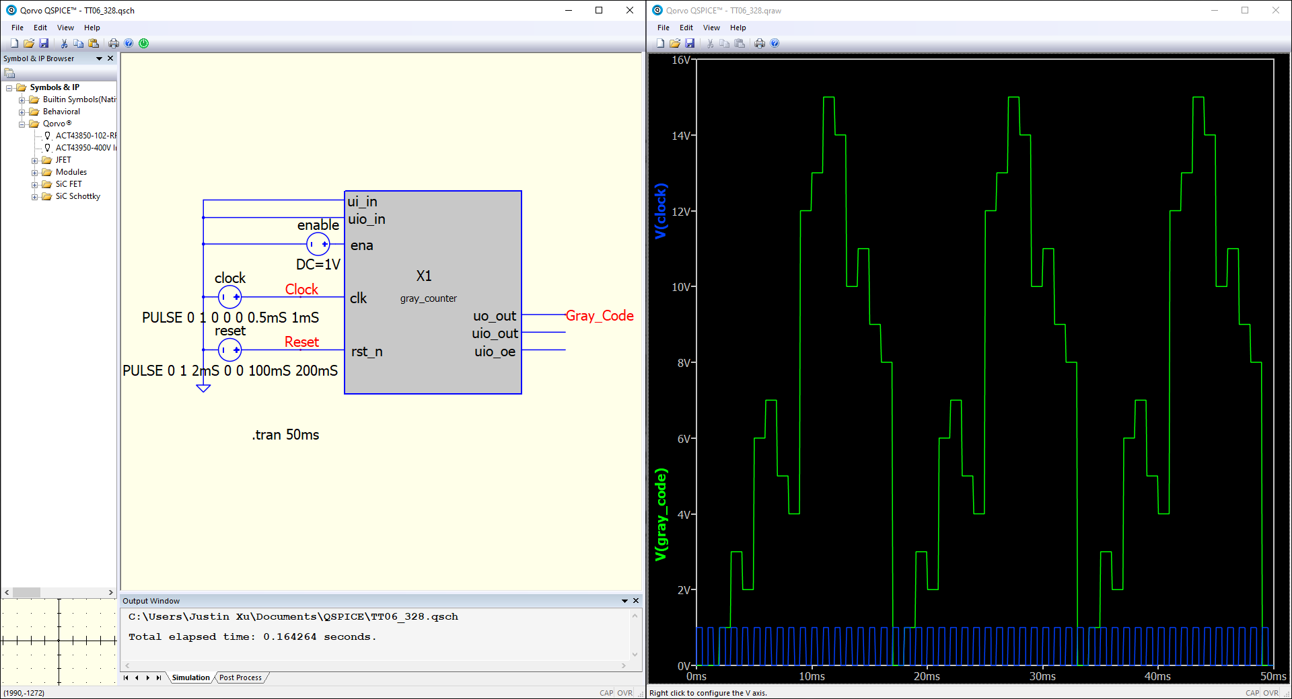

Slide 4
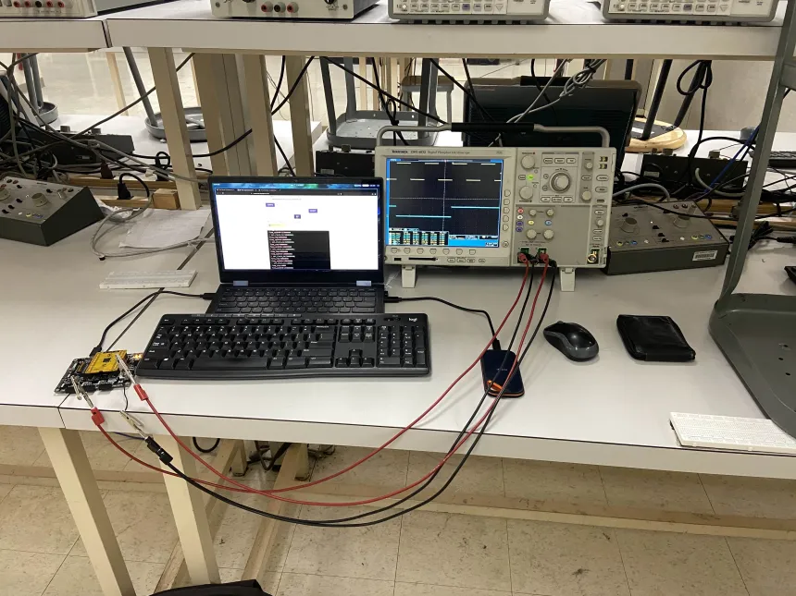
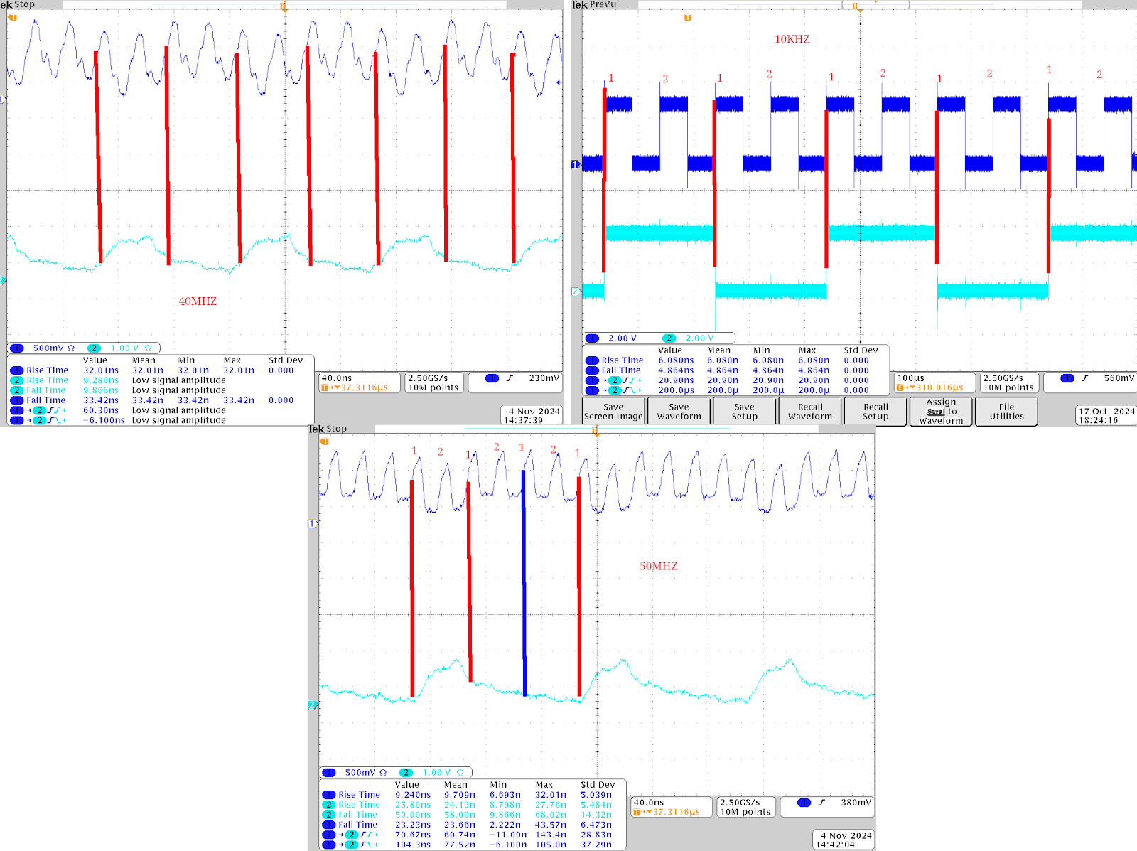
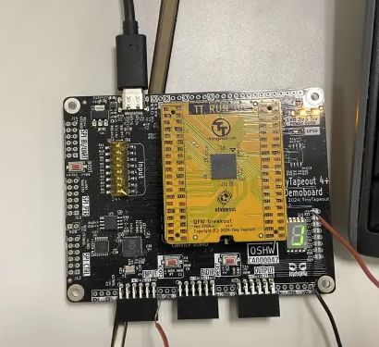
TT05: Testing of the Gray Code Counter
Propagation delay
Rise and fall time
Clock frequencies
Setup (Right Pictures)
40Mhz 10Khz
50Mhz
Notes:
2 Justin Xu
Explanation of exactly what things do and what has been done, such as measurements
CRC- error detection algorithm (cyclic redundancy check)

